Slide 1



The Pet Project Company's Pack n’ Pet

Slide 2
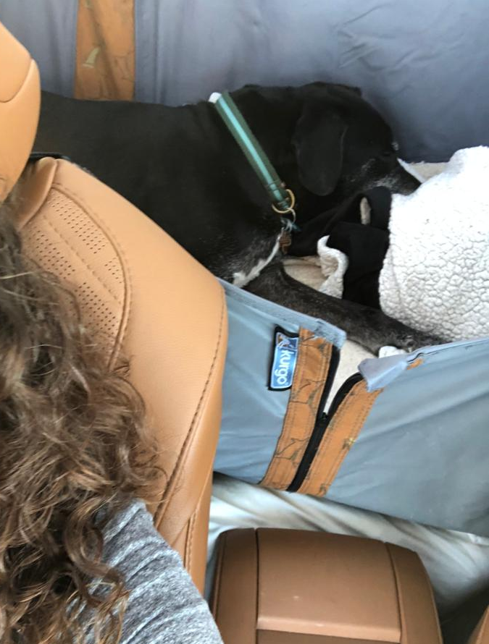
Meet Napoleon
Who here as a pet?
We tried traveling with our pets, and Napoleon was MISERABLE

Slide 3
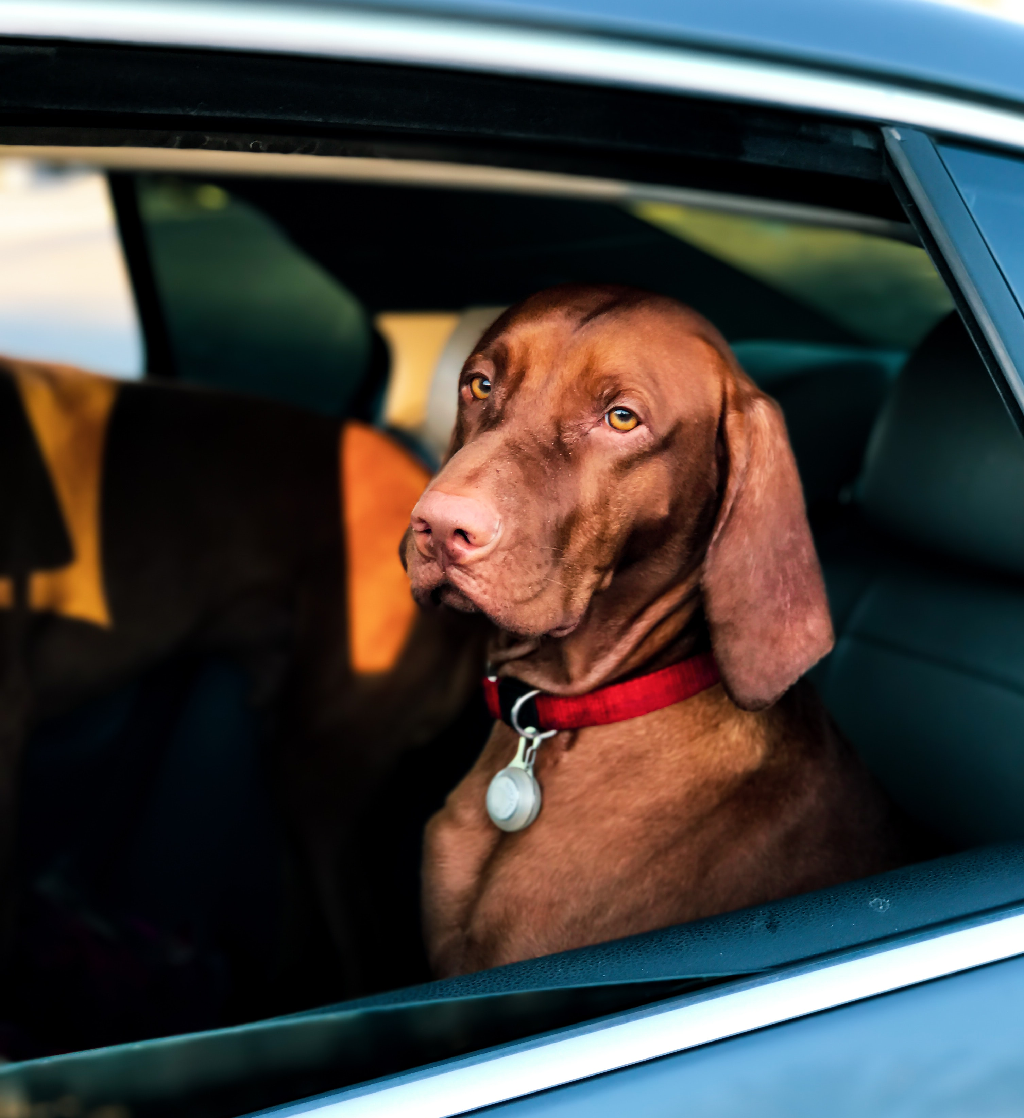
Business Concept
Who we are:
Pack n' Pet is an eCommerce-first brand focused on pet wellbeing
How we operate:
eCommerce
Outsourcing (Supply & Distribution)
Push to Retail

Slide 4
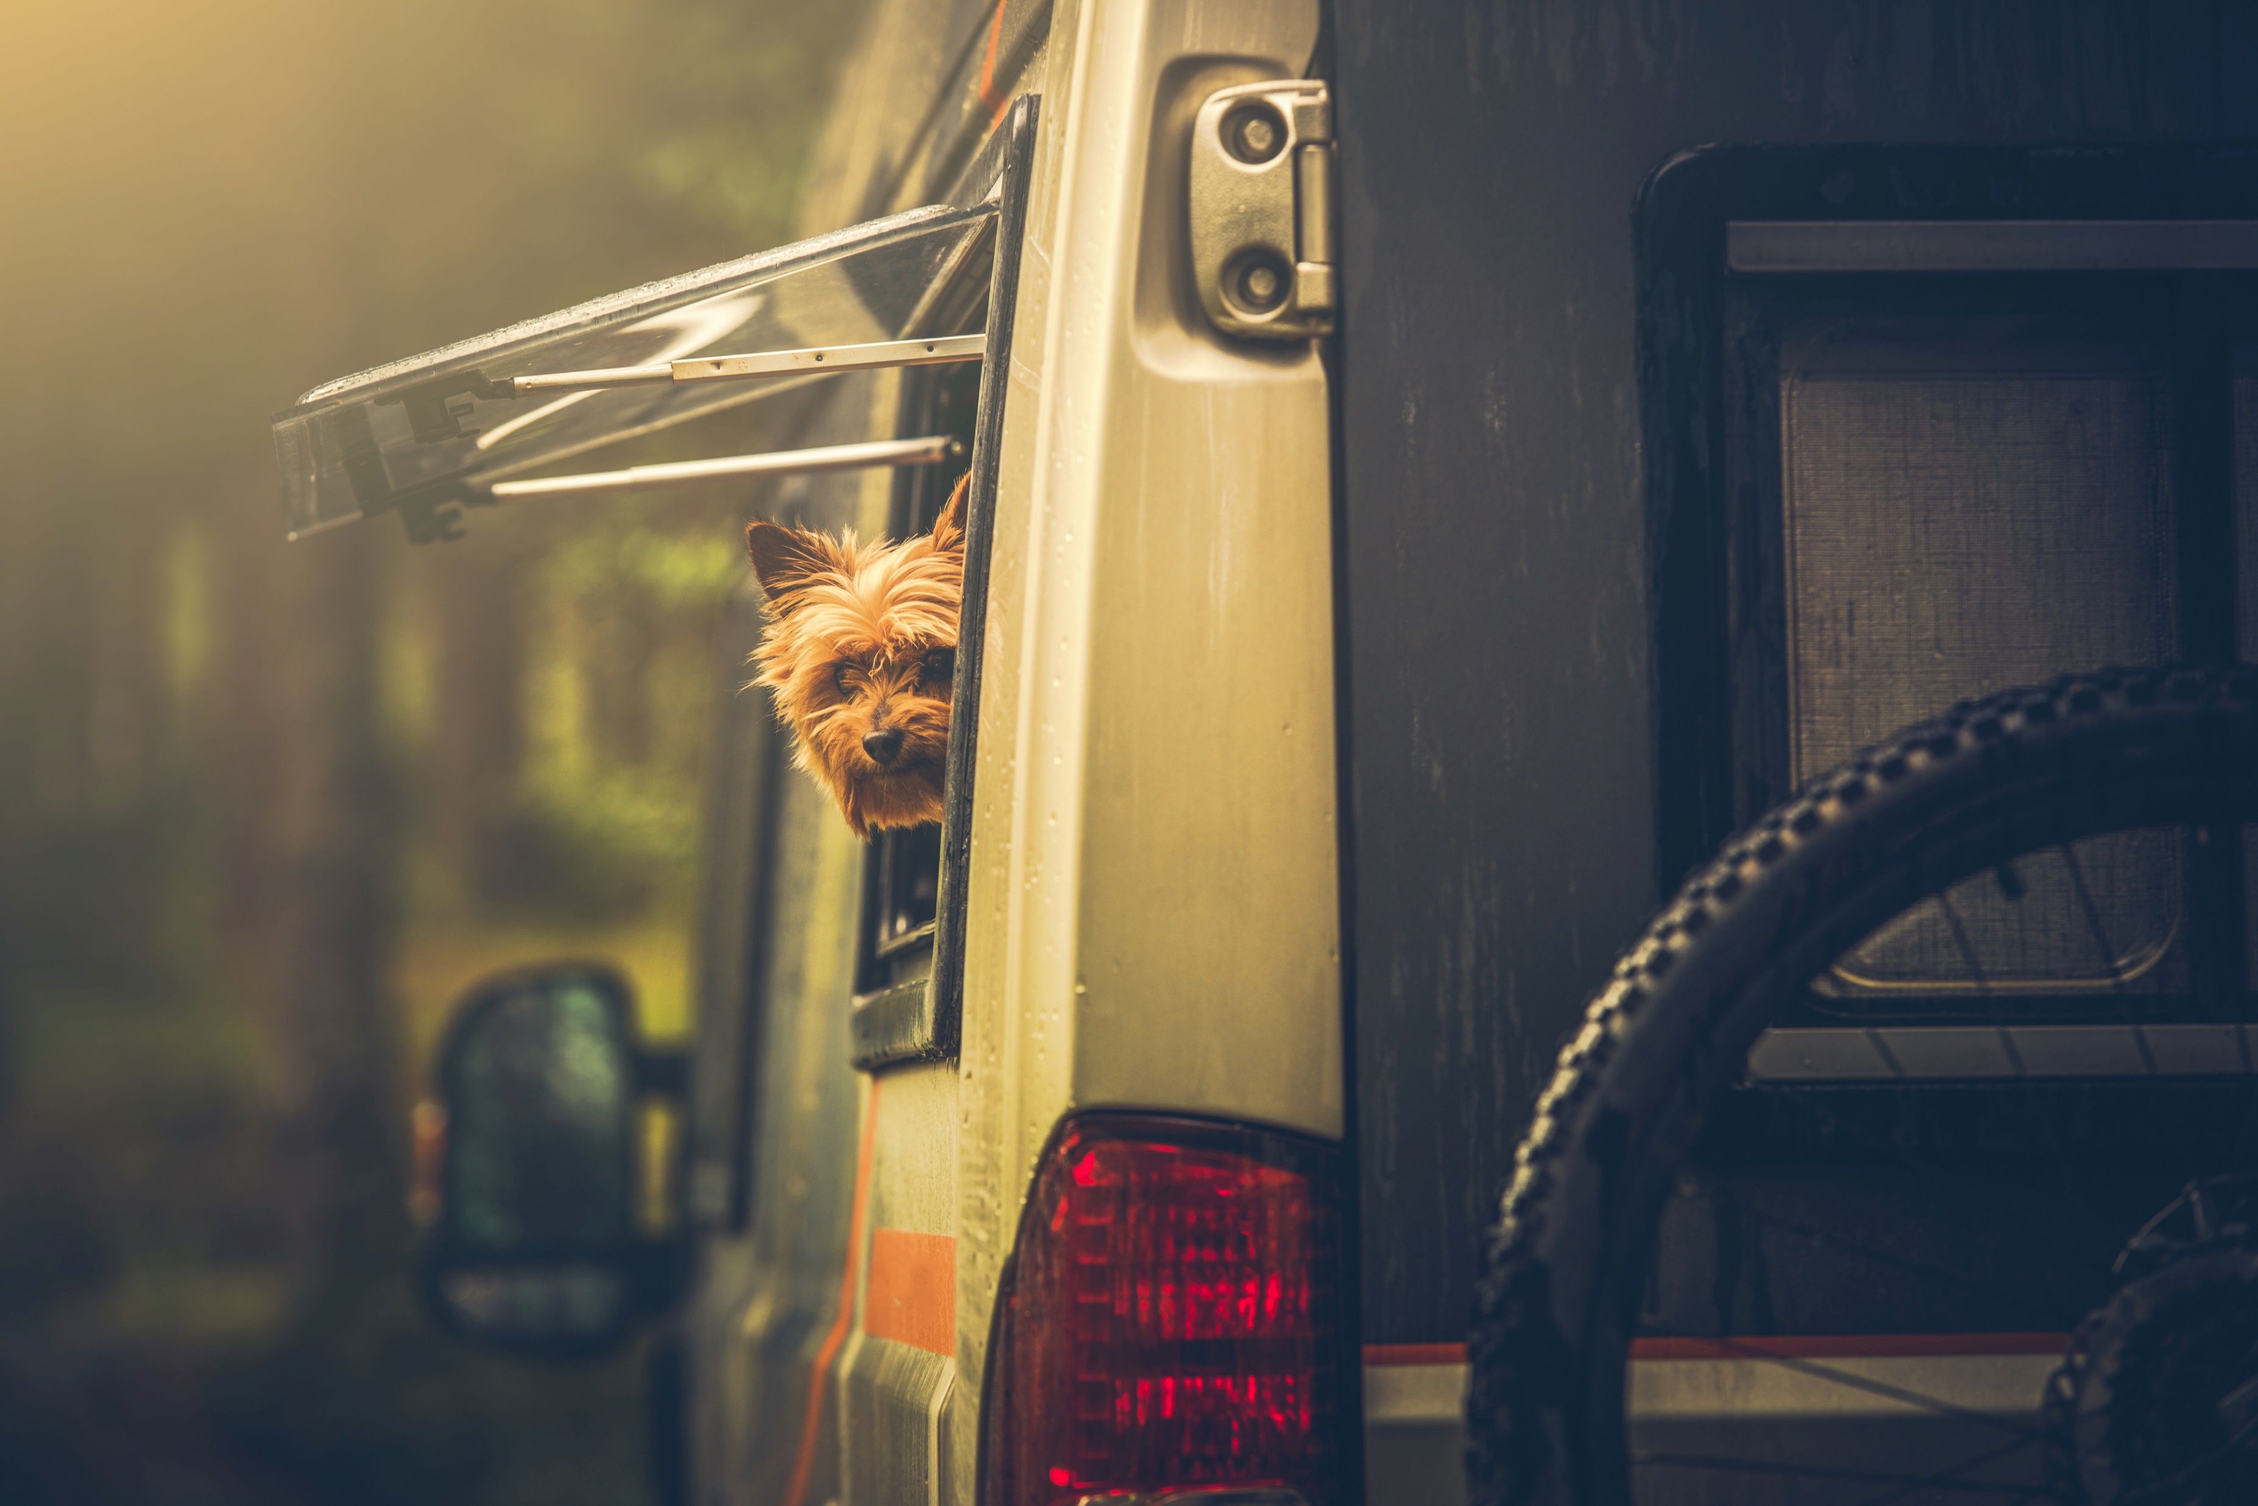
Our Mission & Strategy
Mission: Provide the safest, most comfortable traveling solution for your furry pal in any ride
Strategy: To target pet owners with large SUVs and Minivans
Goals:
Short Term – Sell 300,000 units in first 3 years
Long Term – Expand product line and become #1 consumer pet comfort brand

Slide 5
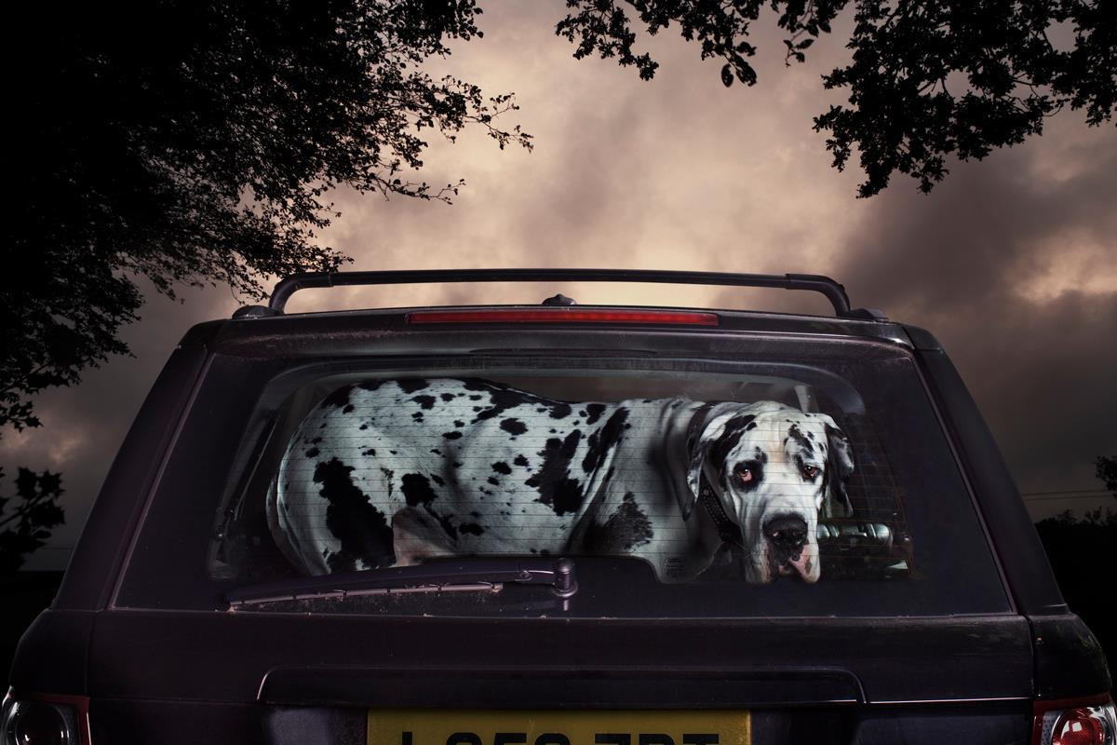
Problem Statement
Pet owners can't find solutions to transport their pets comfortably in different vehicles.
The current offerings are not a true “one-size-fits-all”.

Slide 6
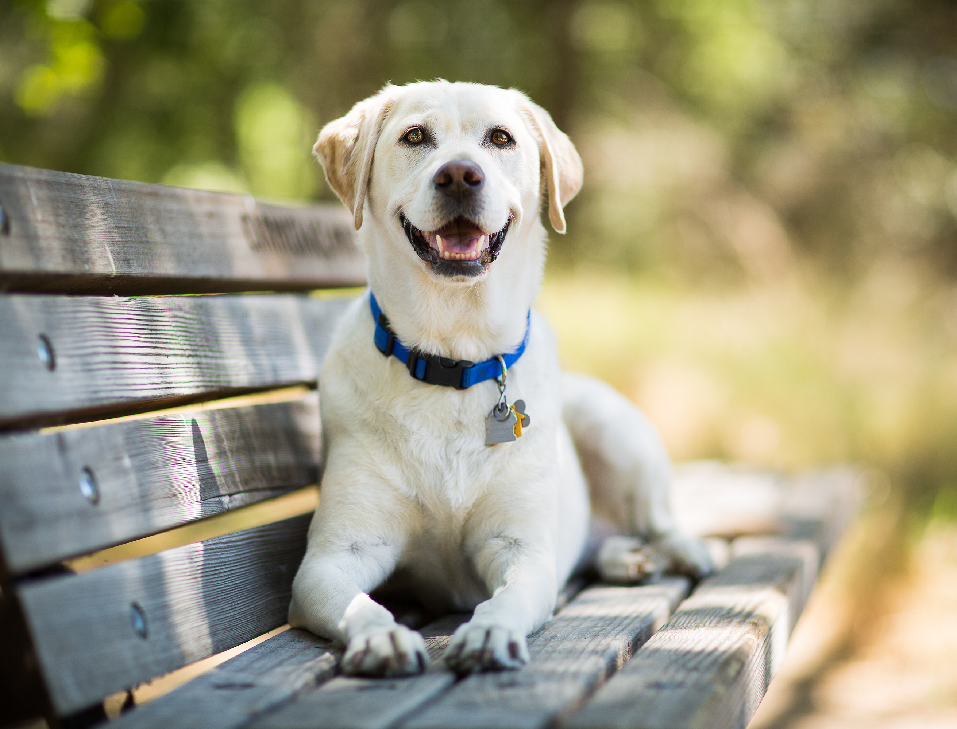
Market Opportunity and Unmet Need
Market Opportunities
Untapped market
Growing pet market
Changing work practices
Treating pets like family members
Data Supporting Unmet Need
Convenance survey at White Rock Lake Dog Park
Interview 7 dog owners around Dallas
Interview veterinarian at VCA Lakewood Animal Hospital
52% of people say this have this issue
57% of people say they would buy this product
Notes:
People willing and apply to buy this product

Slide 7
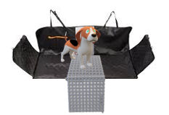
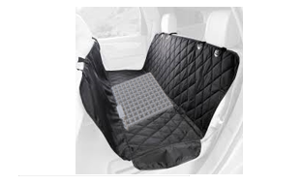
Solution and Unique Value Proposition
A durable pet hammock with a center cushion that forms a base for pets to lay on in vehicles with captain's chairs, or for added cushion for vehicles with bench seating. The Pack n' Pet also provides liners of varying textiles to provide pet owners the option to utilize different materials for different activities/experiences. Pack n’ Pet additionally addresses an unmet need in the market for a comfortable and safe solution for pet transport for all types of vehicles.
With platform in use
With platform folded

Slide 8
Features and Value/Benefits
Features | Value/Benefits
Fastening Slots | Tighter seat fitment, reduces movement
Pockets for Storage | Accessibility/Convenience
Median Cushion | Only solution that works with captain’s chairs
Canvas and Nylon Liners Ex. “Rainy Day Doggie” | Versatility, Convenience, Cleaner Pet Transport, & Flexibility
Production/Assembly in China | Low production cost, high quality, easy startup
Production Budget: $42.21

Slide 9
Industry Overview and Market Analysis
Amount spent on pet Industry in 2020
$103.6 B
Amount spent on pet supplies
$22.1 B
Amount spent on dogs
$9.01 B
Notes:
Grpwing rapidly, tons of money here- opportunity,

Slide 10
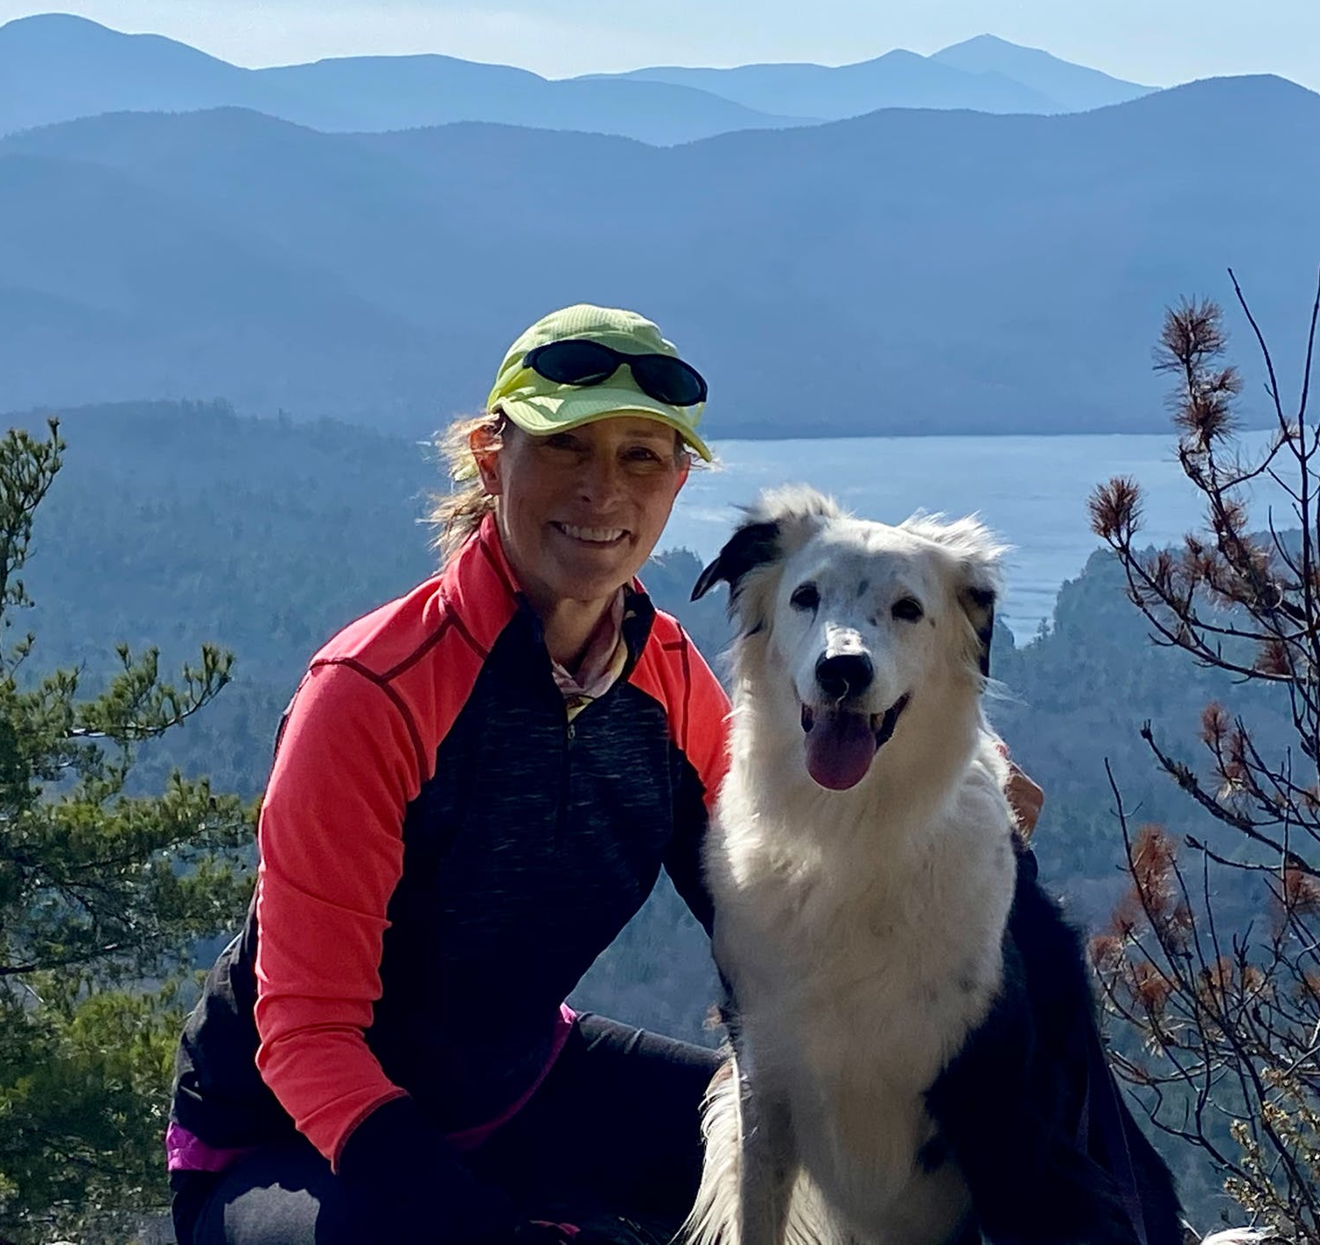
Industry Overview and Market Analysis Creates Pack n' Pet Customer Persona
Industry Overview
Growing pet market/spending
Changing work practices (work from home)
Treating pets like family members
Pack n' Petters Persona
Demographic: Aged 28 (young professional)
Job: Software developer, works from home
Hobbies: travel, Instagram, pampering her pet, hiking, going to dog parks
Motivation: Work-life balance, staying active
Notes:
Persona
Young professionals, working from home, treat pets like family members, they drive their pets to the dog park, take pets on family road trips,
Demographic: Aged 28 (young professional), married with one kid, has money to spend on pets
Job: Software developer, works from home
Hobbies: travel (takes her dog on road trips), pet Instagram account, pampering her pet, hiking
Motivation: Work-life balance, spending time with family and friends

Slide 11
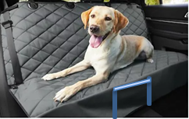
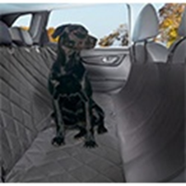
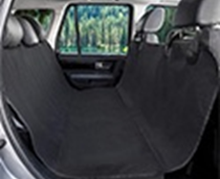
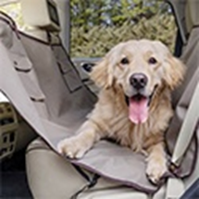
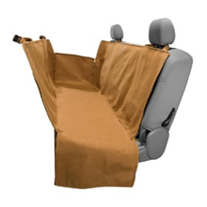
Competitive Analysis
Pack n' Pet | Plush Paws - Quilted | BarksBar Original Waterproof | PetSafe Happy Ride | Carhartt C0001432
$75.00 | $46.00 | $19.99 | $42.95 | $119.99
Support for cars with captain chairs, comfort, flexibility for different activities. | Quilted, extra thick support, comes in a choice of three colors. | Hammock is made from waterproof polyester. | The PetSafe Happy Ride Hammock is waterproof. | Imported material with quick installation for universal fitting.

Slide 12
Competitive Analysis
High Quality
Carhartt
$119.99
Pack’n Pet
$75.00
PlushPaws $46.00
PetSafe
$42.95
Low Price
High Price
BarksBar
$19.99
Low Quality

Slide 13
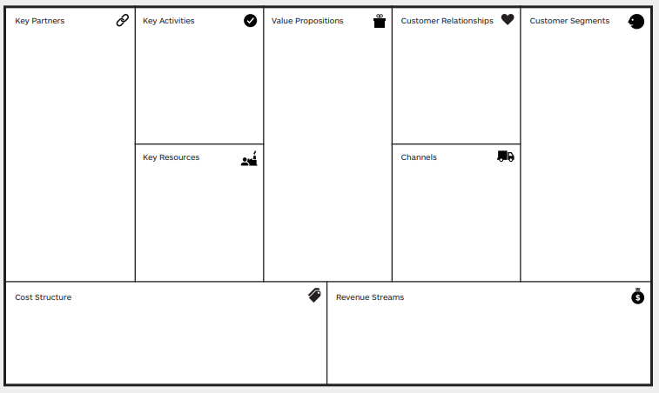
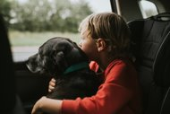
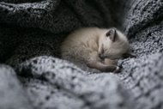
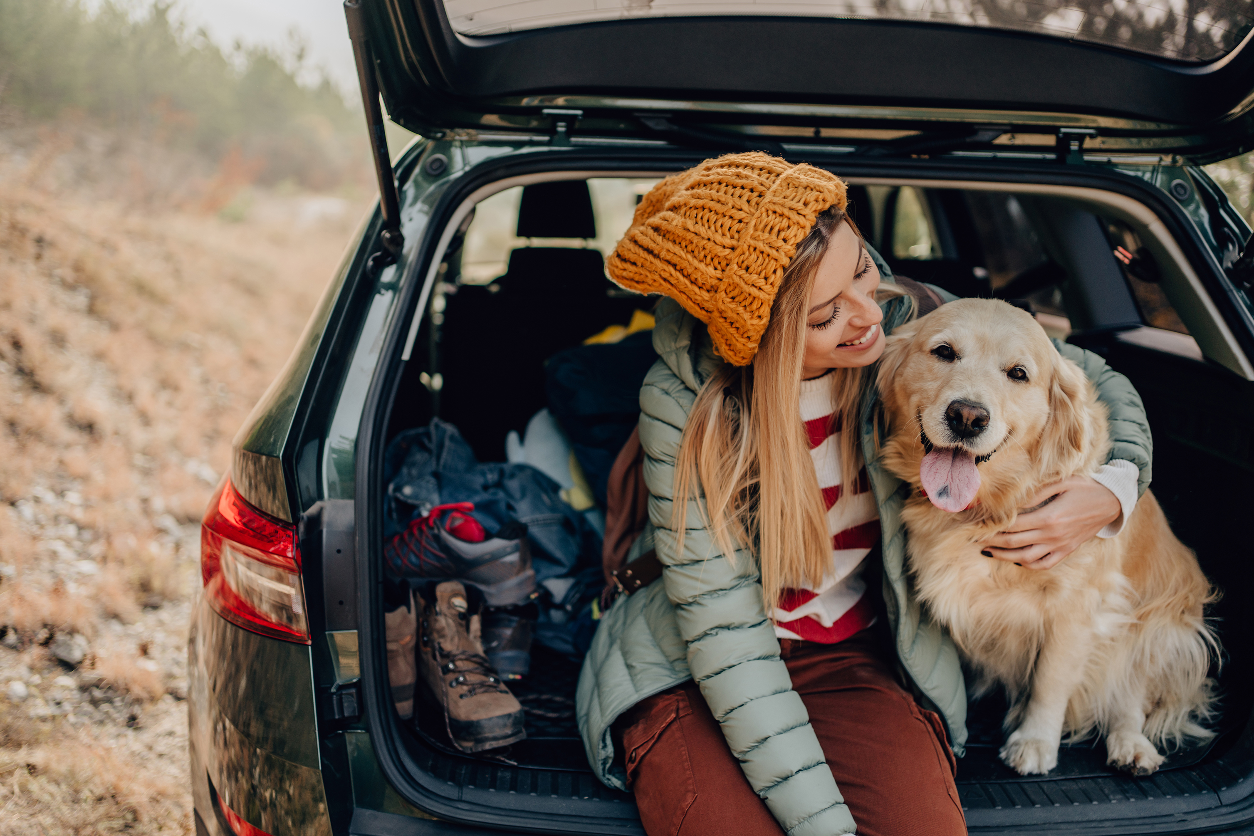
Business Model
- Interchangeable, washable, liners ​- Additional comfort compared to solutions (additional padding)​
- Platform between the captain’s chairs ​- Easier and cleaner pet transport ​
- Provides flexibility to pet owners and pets Works in ANY car, only need to purchase one
- offer guarantee/warranty
- offer other products/features/ add-ons
- customer service
- loyalty program once we extend the brand/product line
On-the-go, apartment-dwelling pet lover
- go to the dog park often
Frequent traveling pet-centric family
- go on lots of road trips
-Ecommerce engines
-Pet stores/buyers
-Investors
-Manufacturer
-Strategic alliances with shelters/orgs
- Gain feedback often on product in startup stage
- Gather data
- Conduct trials
Patent
Capital
Distribution
Suppliers
- ecommerce
- pet stores
- pop-ups
We have both fixed and variable expenses. The most expensive part of the product is the COGM. Initial website development and marketing efforts are also considerable expenses but do not depend on sales.
- direct sales

Slide 14

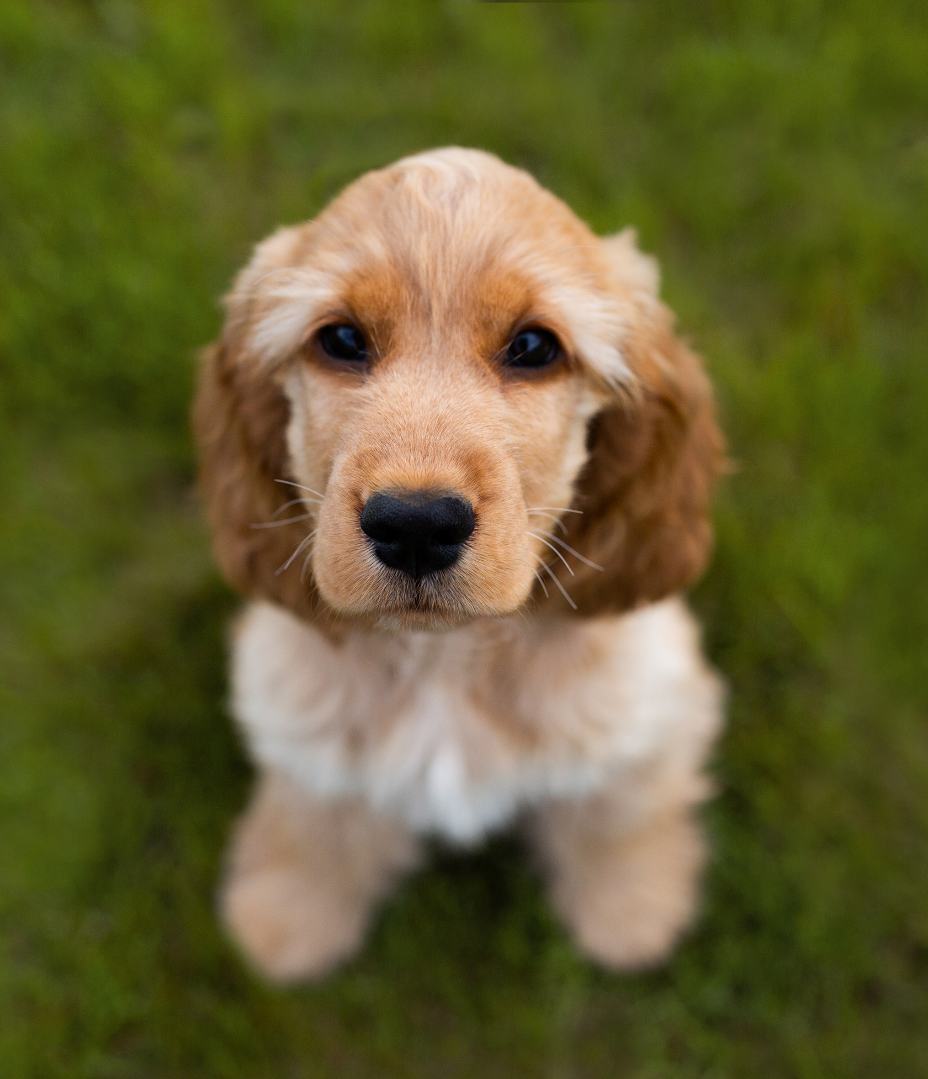

Marketing Plan
Advertising and Promotional Activities
July 2023 – January 2024: Website Launch, Social Media Targeting, and Pop-ups
January 2024 - May 2024: Pre-retail push campaign
June 2024 and Future: Drive sales primarily through e-commerce and grow in retail space
Pricing, Distribution, Service & Support
Competitive, Mid-market Pricing
Direct Consumer Sales, eCommerce Focus, Plans to Penetrate Retail
Warranty, Loyalty Program, & “Pick up the phone” model
Sales Forecasts
Projected conservative growth of 5% YoY starting at an estimated 120k units/year
Notes:
A Comprehensive Marketing Plan: This section of the plan should include a summary analysis of the target market(s), the reason for selecting a specific market segment, the general market strategy and positioning among competitors, imaging of the firm, advertising and promotional activities, pricing strategy, sales and distribution strategy, service and support plan, sales forecasts and detailed marketing budget ($500,000 – break it down)

Slide 15



Marketing Plan
Market Segment
Pet owners working from home with SUVs and minivans
Positioning Among Competitors
Pack n' Pet seeks to be a competitor in the pet hammock market by offering a more comprehensive product than other brands
Imaging
Pack n' Pet wants to project an image of quality, comfort, and safety.
Notes:
A Comprehensive Marketing Plan: This section of the plan should include a summary analysis of the target market(s), the reason for selecting a specific market segment, the general market strategy and positioning among competitors, imaging of the firm, advertising and promotional activities, pricing strategy, sales and distribution strategy, service and support plan, sales forecasts and detailed marketing budget ($500,000 – break it down)

Slide 16
Timeline/Milestones

Slide 17
Break-Even Chart with Summary Income Statement
 | Year 1 | Year 2 | Year 3
Revenue: | $ 3,750,000.00 | $ 9,450,000.00 | $ 9,922,500.00
Costs: | ($4,174,193) | ($8,419,861) | ($8,767,692)
Profit/Loss: | ($424,193.33) | $1,030,138.80 | $1,154,808.24
Income: | - | $1,030,138.80 | $1,154,808.24

Slide 18
Summary Table of Budget & Use of Proceeds
 | 2023 | 2024 | 2025
Capital Expenditures:
Website: | ($60,000) | $0.00 | $0.00
LLC Incorporation: | ($300) | $0.00 | $0.00
Expenses:
Website Maintenance: | ($5,000) | ($12,000) | ($12,000)
COGM: | ($2,410,560) | ($6,074,611) | ($6,378,342)
Marketing & Partnerships: | ($458,333) | ($525,000) | ($551,250)
Employee Salaries & Benefits: | ($900,000) | ($900,000) | ($900,000)
Estimated Total/Break-Even Cost: | ($19,187,396)

Slide 19
Critical Risk Factors & Non-Financial Resource Requirements
Critical Risk Factors
 | Risk | Mitigation
Economic Risk: | International Tensions & Shipping | Save Money & Domestic Partners
Competitive Risk: | Copycats & Look-alikes | Patents & Marketing
Operational Risk: | Supply Chain Dislocation | Domestic Partners, Future Warehousing
Financial Risk: | “Eggs in One Basket” | Product Diversification and Acquisitions
Non-Financial Resources
Tangible: | Equipment & Website
Intangible: | Patents, Goodwill, IP, Investor Relations, PR, Supplier & Distributor Relationships

Slide 20
Appendix

Slide 21
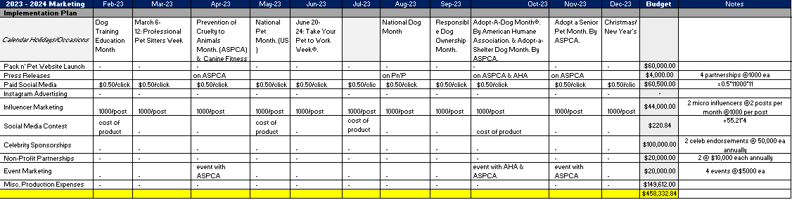
Marketing Plan
Detailed Marketing Plan and Budget
Notes:
A Comprehensive Marketing Plan: This section of the plan should include a summary analysis of the target market(s), the reason for selecting a specific market segment, the general market strategy and positioning among competitors, imaging of the firm, advertising and promotional activities, pricing strategy, sales and distribution strategy, service and support plan, sales forecasts and detailed marketing budget ($500,000 – break it down)

Slide 22
Assumptions for Financials
Our company wins the Texas Business Idea Competition
Without this, we would allocate more time to “Friends/Family Rounds” and raise additional capital
Business is incorporated as a private LLC on March 30th, 2023
Website development is an up-front cost expensed on March 30th, 2023
Marketing efforts begin on February 1st, 2023
Sales begin on August 1st, 2023
Corporate tax rate will remain constant over the next 3 years
Salaried employees will maintain current salaries/benefits through 2027
All 6 employees hired will be fully capable in their respective fields and able to run a division on their own until further hiring is done
Marketing & Partnership spend starts at a base of $500,000 and increases 5% YoY
Much of the marketing is outsourced
Estimated Sales Quantity starts at a base of 120,000 units and increases 5% YoY
All excess from inception to December 30th, 2027, will be paid back to shareholders proportionately (See Excel Workbook – Brandon’s: “Investment Offer & Return”)
All business is initially done via eCommerce (eventually also breaking into retail markets)
Product is shipped directly from supplier, will have longer lead-times but requires less working capital
Distribution partnerships become essential in later stages to reduce shipping times and deployment in the U.S.
Investors are paid back at the end of the 5th year, 2027
*All financials and forecasts created without the results of investing rounds*
FOR UPDATED ASSUMPTIONS, SEE EXCEL DOC: “Appendix – MS Excel”

Slide 23


Product Features/Benefits
This product benefits any pet customer because it functions as both a car hammock for pets with added cushion when folded up, or as a hammock with platform when in a car with captain's chairs.
This product should replace the standard hammocks that most pet owners buy so that they are prepared for any situation and provide their pets with maximum comfort.
The pricing is competitive with other pet hammock suppliers without the platform and offers better quality and better overall performance.
This product will fit the needs of any medium or large pet consumer that does not want their pet uncomfortable during transportation.

Slide 24
Appendix: Competitive Features
Pack n' Pet | Plush Paws - Quilted | BarksBar Original Waterproof | PetSafe Happy Ride | Carhartt C0001432
Waterproof Liners | Waterproof Polyester | Quilted Luxury comfort | Storage Pockets | Seat wedges
Works in cars, trucks, and SUVs | Works in cars, trucks, and SUVs | Drape design, adjustable harness | Adjustable Design | Zippers for convertible fitting
Support median for captain chairs | Fastening slots | Plush/padded Material | Waterproof | Universal fit
Plush material | Machine Washable | Machine Washable |  | Machine Washable
Fastening slots |  | Seatbelt openings |  | Seatbelt buckle access panels
Cons
 | Not as durable | Straps need tightening | No air vents | Not waterproof
 |  |  | Not for smaller cars | No plush padding
 |  |  | No plush padding

Slide 25
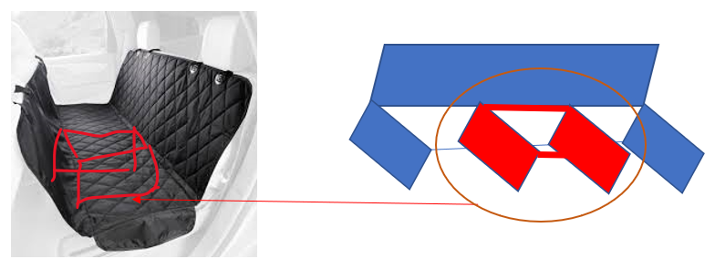
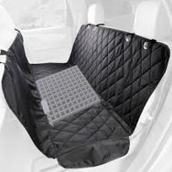
Appendix: Product Design/Development
Key features: Fastening Slots, Pockets for storage, Median Cushion, Canvas and Nylon Liners ( Rain Proof depending on purchase, and Plush undercover)
Product Cost Budget : $42.21
Materials Produced:
Nylon/Canvas liners
plush undercover
median cushion
Raw Materials will be purchased, and assembly will be outsourced to China. Branding and packaging will be combined at production phase.

Slide 26
Product Concept & Development
A pet hammock with a built-in portion that can be folded out for a sturdy but comfortable support (like a mini padded table top) to go between captain's chairs in the second row, designed to fill the space so pets can comfortably lay across the entire row, and not just one small seat. For vehicles without captain’s chairs, the foldable base doubles up as an ergonomic solution for pet owners with small-mid size vehicles.
Fastening Slots
Pockets for Storage
Median Cushion
Canvas and Nylon Liners Ex. “Rainy Day Doggie”
Production/Assembly in China Production Budget: $42.21

Slide 27



Solution and Unique Value Proposition
The Solution: A durable pet hammock with a center cushion that forms a base for pets to lay on in vehicles with captain's chairs, or for added cushion for vehicles with bench seating. The Pack n' Pet also provides liners of varying textiles to provide pet owners the option to utilize different materials for different activities/experiences. Pack n’ pet additionally addresses an unmet need in the market for a comfortable and safe solution for pet transport for all types of vehicles.
Unique Value Proposition:
Easier and cleaner pet transport
Interchangeable, washable, liners
Only solution that works for large SUVs
Additional comfort compared to competitors (additional padding)
Provides flexibility to pet owners and pets (Works in ANY car, only need to purchase one)

Slide 28
Works Cited
Boitnott, John. “Types of Business Risks to Plan For.” Business Class: Trends and Insights | American Express, https://www.americanexpress.com/en-us/business/trends-and-insights/articles/7-business-risks-every-business-should-plan-for/.
“Barksbar Original Waterproof Car Seat Cover, Standard.” BARKSBAR Original Waterproof Car Seat Cover, Standard - Chewy.com, https://www.chewy.com/barksbar-original-waterproof-car-seat/dp/181116?utm_source=partnerize&utm_medium=affiliates&utm_campaign=1011l93523&utm_content=0&clickref=1101lj5z5g9P&utm_term=1101lj5z5g9P.
Boom or bust - American Pet Products Association. (n.d.). Retrieved November 17, 2021, from https://americanpetproducts.org/Uploads/MarketResearchandData/2021StateoftheIndustryPresentationDeck.pdf.
Borrelli, Lena. “Car Ownership Statistics.” Bankrate, 26 July 2021, https://www.bankrate.com/insurance/car/car-ownership-statistics/#:~:text=For%20most%20American%20families%2C%20cars,a%20day%20in%20the%20car.
Cosgrove, Nicole. “10 Best Dog Car Hammocks of 2022 - Reviews & Top Picks.” Hepper, 8 Mar. 2022, https://www.hepper.com/best-dog-car-hammock/.
“Facts + Statistics: Pet Ownership and Insurance.” III: Insurance Information Institute, https://www.iii.org/fact-statistic/facts-statistics-pet-ownership-and-insurance#:~:text=Seventy%20percent%20of%20U.S.%20households,and%2067%20percent%20in%202019.
Kagan, Julia. “Corporate Tax.” Investopedia, Investopedia, 8 Feb. 2022, https://www.investopedia.com/terms/c/corporatetax.asp.
Mitic, I. “20 Insightful Pet Spending Statistics (2022).” Fortunly, 6 Jan. 2022, https://fortunly.com/statistics/pet-spending-statistics/#gref.
“Non-Financial Asset.” Corporate Finance Institute, 6 Mar. 2022, https://corporatefinanceinstitute.com/resources/knowledge/accounting/non-financial-asset/#:~:text=Examples%20of%20non%2Dfinancial%20assets,%2C%20goodwill%2C%20and%20intellectual%20property.
Pet industry market size, Trends & Ownership Statistics. American Pet Products Association. (n.d.). Retrieved April 22, 2022, from
https://www.americanpetproducts.org/press_industrytrends.asp
"Pet Hammock Photo". https://encrypted-tbn0.gstatic.com/images?q=tbn:ANd9GcSbsqzp0nx-YgzDOC4ZlzG4eS69SKYDYdlMhw&usqp=CAU.
“Petsafe Happy Ride Waterproof Hammock Dog Car Seat Cover, Beige.” PETSAFE Happy Ride Waterproof Hammock Dog Car Seat Cover, Beige - Chewy.com, https://www.chewy.com/petsafe-happy-ride-waterproof-hammock/dp/53697?utm_source=partnerize&utm_medium=affiliates&utm_campaign=1011l93523&utm_content=0&clickref=1100lj5qpJui&utm_term=1100lj5qpJui.
“Plush Paws Products Quilted Hammock Car Seat Cover, Black, Regular.” PLUSH PAWS PRODUCTS Quilted Hammock Car Seat Cover, Black, Regular - Chewy.com, https://www.chewy.com/plush-paws-products-quilted-hammock/dp/133245?utm_source=partnerize&utm_medium=affiliates&utm_campaign=1011l93523&utm_content=0&clickref=1101lj5z5exR&utm_term=1101lj5z5exR.

Slide 29
Works Cited p.2
PRESIDENT, Bill Craig WEBFX. “How Much Does a Website Cost in 2022?: Builders, Agencies, & More.” WebFX: Digital Marketing That Drives Revenue, 24 Mar. 2022, https://www.webfx.com/web-design/pricing/website-costs/.
Reiff, Nathan. “Series A, B, C Funding: How It Works.” Investopedia, Investopedia, 24 Feb. 2022, https://www.investopedia.com/articles/personal-finance/102015/series-b-c-funding-what-it-all-means-and-how-it-works.asp.
Research, Sandler. “Pet Care Market to Grow at 4.72% CAGR to 2020.” Pet Care Market to Grow at 4.72% CAGR to 2020, Cision PR Newswire, 29 June 2018, https://www.prnewswire.com/news-releases/pet-care-market-to-grow-at-472-cagr-to-2020-594893381.html#:~:text=Pet%20retail%20stores%20are%20estimated,well%2Dbeing%20of%20their%20pets.
“Serviceable Obtainable Market (SOM).” Corporate Finance Institute, 24 June 2020, https://corporatefinanceinstitute.com/resources/knowledge/strategy/serviceable-obtainable-market-som/.
Staff, Science X. “Sociologist Confirms What Pet Parents Know: Pets Really Are Part of the Family.” Phys.org, Phys.org, 16 July 2021,
https://phys.org/news/2021-07-sociologist-pet-parents-pets-family.html.
“Tam Sam Som - What It Means and Why It Matters.” The Business Plan Shop, 8 Feb. 2022, https://www.thebusinessplanshop.com/blog/en/entry/tam_sam_som#:~:text=TAM%20or%20Total%20Available%20Market,SAM%20that%20you%20can%20capture.
“Texas LLC, Business License, Incorporation.” Incorporate.com, CSC, https://www.incorporate.com/learning-center/texas/#:~:text=Cost%20to%20Incorporate%20in%20Texas&text=A%20certificate%20of%20formation%20for,to%20pay%20a%20%2425%20fee.
“The 8 Best Dog Seat Covers of 2022.” The Spruce Pets, www.thesprucepets.com/best-dog-seat-covers-4686813. Accessed 22 Apr. 2022.
Cosgrove, Nicole. “10 Best Dog Car Hammocks of 2022 - Reviews & Top Picks.” Hepper, 21 Jan. 2020, www.hepper.com/best-dog-car-hammock/. Accessed 22 Apr. 2022
Tyler, Jordan. “Pandemic-Era Pet Industry Surpasses Record-Breaking $100 Billion in Sales.” Pet Food Processing RSS, 25 Mar. 2021, https://www.petfoodprocessing.net/articles/14588-pandemic-era-pet-industry-surpasses-record-breaking-100-billion-in-sales.
“Universal Fitted Nylon Duck Pet Hammock | Automotive | Carhartt.” Carhartt.com, 2022, www.carhartt.com/product/801969/universal-fitted-nylon-duck-pet-hammock. Accessed 22 Apr. 2022.

